Slide 1
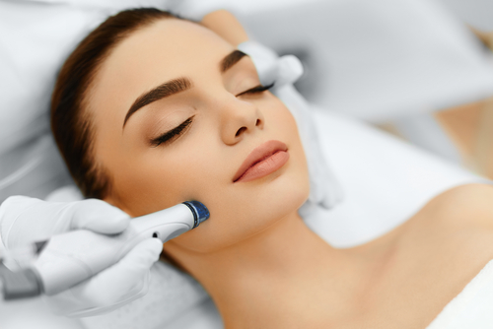
Microdermabrasion

Slide 2
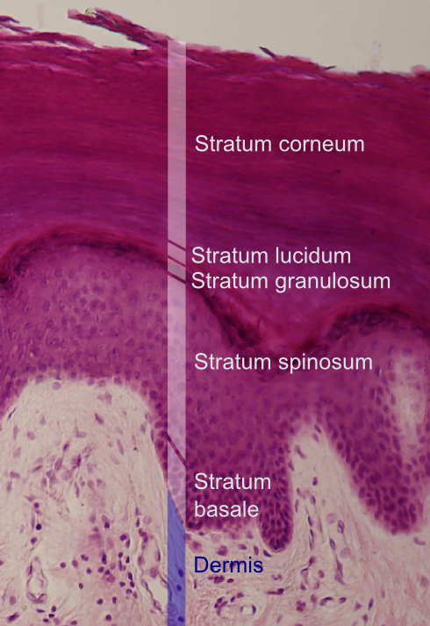
What is Microdermabrasion?
Microdermabrasion operates on the premise that encouraging exfoliation of the skin is desirable. That means that the benefits of skin exfoliation are numerous and the results are positive for the person treated. The word “micro” is used to separate this procedure from true dermabrasion, where the deeper layers of the skin are removed. By using a motorized brush system (a specific machine)and bombarding the skin with high-speed particles of exfoliating crystals or diamond flakes it is possible to remove desquamating corneocytes (dead cells which constitute almost entirely the outermost layer of epidermis), and make the skin smoother and softer with a better color.

Slide 3
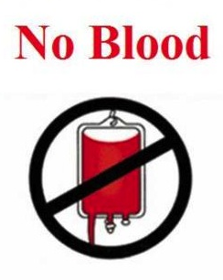
What is Microdermabrasion? (suite)
It is important not to go any deeper into the skin than the first few layers of stratum corneum (outermost layer of epidermis) to avoid scarring and other problems. Microdermabrasion can be used by a trained skin care professionals because it does not enter the living layers of the skin; any procedure that enters the living layers of the skin and causes bleeding should be performed only by a physician.

Slide 4
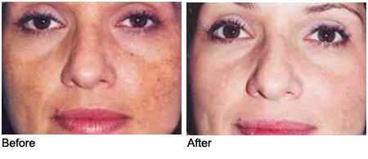
What Microdermabrasion does
In addition to removing the top layer of the skin and thus clearing the face from dead cells (and promoting natural collagen secretion), microdermabrasion improves the appearance of several aspects of the skin, such as increased pigment, which may be contained in the outer dead cells. This pigment may make the skin look freckled due to the presence of lentigenes, the medical term for brown spots, and scaling brown growths. Microdermabrasion can remove the skin scale that contains the pigment, making the skin more evenly colored. However, it is possible for the brown spots and scaling brown growths to reappear as the skin cells again produce irregular pigment, making the improvement temporary.

Slide 5

Benefits of Microdermabrasion for certain medical conditions
Microdermabrasion helps with a number of medical conditions. It either temporarily or permanently improves it. The following conditions can be treated and improved by microdermabrasion:
  Acne
  Melasma
  Keratosis Pilaris

Slide 6
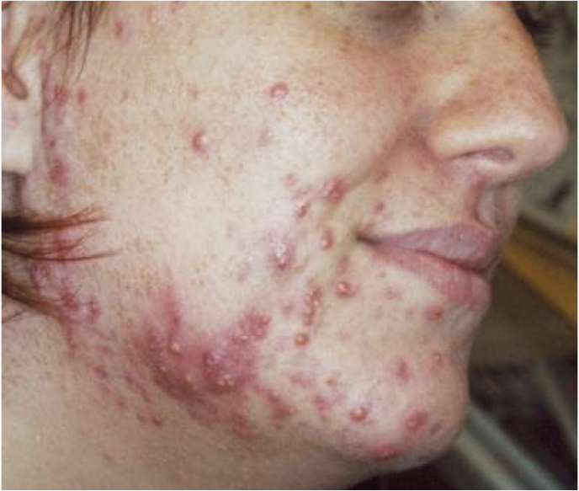
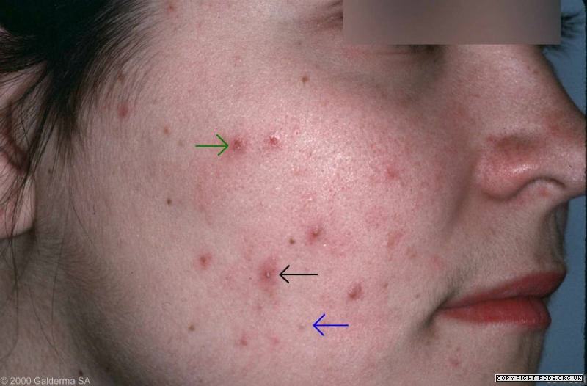
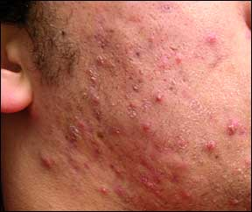
Acne (active and mild)
Active acne, mild acne discoloration, pick marks, and very superficial or raised acne scars can be treated. Microdermabrasion can also be used to unclog pores. Often used in combination with mild glycolic peels and acne extractions. Rivage line has several products for acne treatment which may also be used.

Slide 7
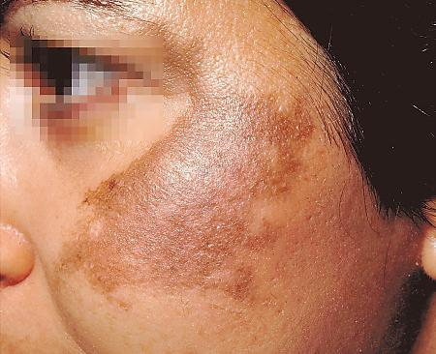
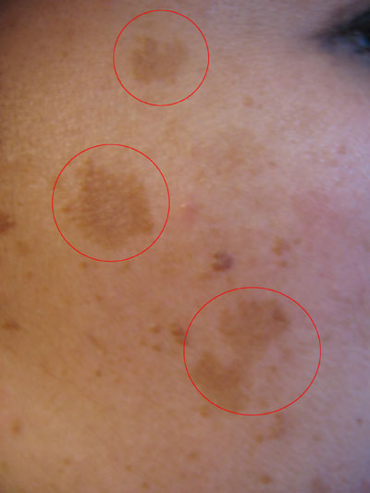
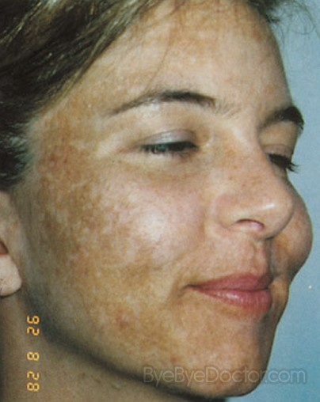
Melasma
Melasma is a dark skin discoloration. Regular treatments combined with glycolic peels and use of sunscreen all the time can bring significant improvement and good results.

Slide 8
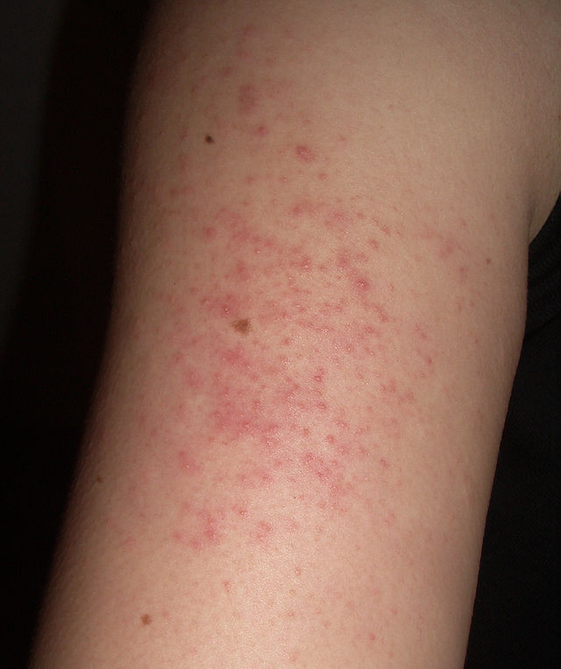
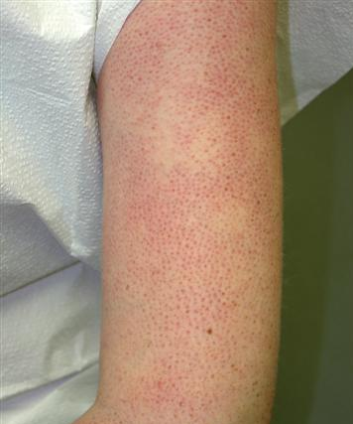
Keratosis Pilaris
It is the appearance of rough, slightly red, bumps on the skin. It most often appears on the back and outer sides of the arm. Those are the areas microdermabrasion is most effective and reduces the redness.

Slide 9

Possible side-effects of microdermabrasion
Potential side effects of microdermabrasion are minimal and this is a very safe procedure. Potential drawbacks are very limited because microderm only affects the epidermis, which is the outermost skin layer.
Possible side effects of microdermabrasion include:
skin tightness,
redness,
minor bruising,
skin sensitivity,
post-inflammatory hyperpigmentation (PIH),
small skin abrasions,
spots of bleeding,
eye-skin bruising (especially if you are taking aspirin or other blood thinners),
High pigmentation from exposure to the sun (which is why we always recommend to the client to put sun protection right after the treatment and avoid the exposure to the sun altogether for a day)
fine broken blood vessels (telangiectasia),
and cold sore reactivation around lips.

Slide 10

Microdermabrasion contraindications
Microdermabrasion is non-invasive and in general is a very safe cosmetic treatment. Yet, there are several contraindications to this treatment. You should NOT perform the treatment if the patient has one or several conditions from the following
Undiagnosed lesions
Recent herpes outbreaks
Warts
Active, weeping acne (stages 3-4)
Active Rosacea
Unstable diabetes
Auto-immune system disorders
Some patient’s hyperpigment post-treatment. Lower pressures are used on follow-up treatments for these individuals.
Using Retin A religiously or just had a chemical peel
Recently had laser surgery/surgery

Slide 11
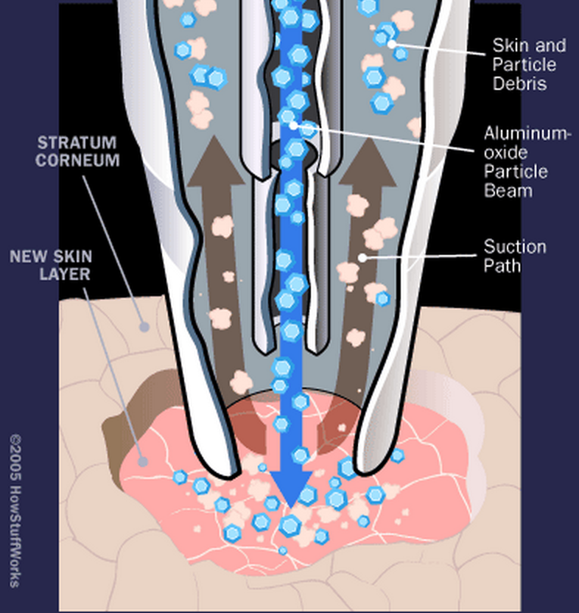
Introduction to Microdermabrasion machines
Typical microdermabrasion sessions can last anywhere from 5 to 60 minutes. The length of procedure, the period of time the face is exposed to suction and how many times the head of the hand-piece passes on specific sections of the face is determined by the skin care professional based on skin type and expectations of the client.
Traditionally, crystal microdermabrasion system contains a pump, a connecting tube, a hand piece, and a vacuum source. While the pump creates a high-pressure stream of inert crystals, such as aluminum oxide, magnesium oxide, sodium chloride, and sodium bicarbonate, to abrade the skin, the vacuum removes the crystals and exfoliated skin cells.

Slide 12
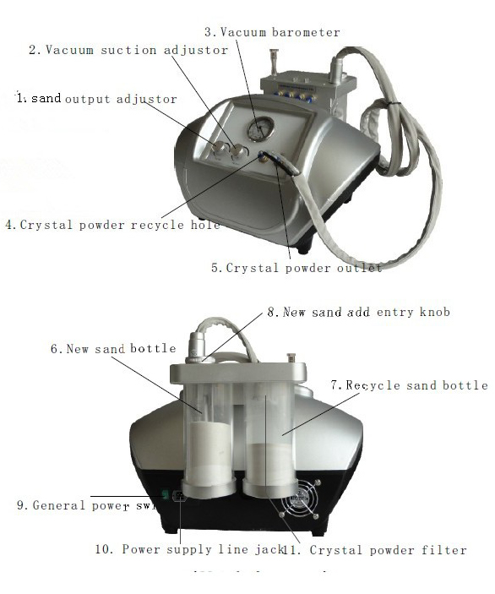
Traditional crystal microdermabrasion
Notice how there are special tubes for crystals, one for new, other is for recycled.
This is a traditional type of machine to use for microdermabrasion. Though still in use today in some clinics, it is not used in ours.

Slide 13
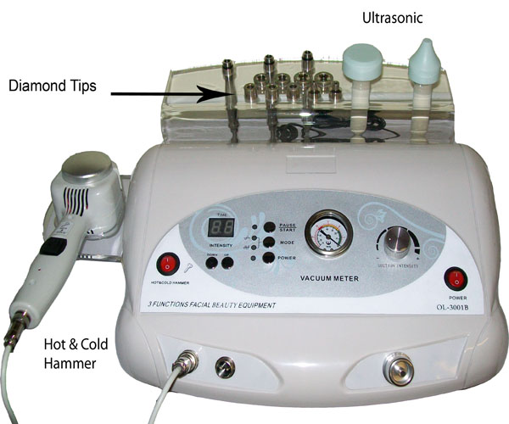
Diamond tip technique
Alternatively, the inert crystals can be and are replaced by a roughened surface of the tip in the diamond microdermabrasion system. Unlike the older crystal microdermabrasion system, the diamond microdermabrasion does not produce particles from crystals that may be inhaled into patients’ nose or blown into the eyes. Hence, diamond microdermabrasion is regarded as having higher safety for use on areas around the eyes and lips. Generally, the slower the movement of the microdermabrasion hand piece against the skin and the greater the numbers of passes over the skin, the deeper the skin treatment. On the picture you can see an example of a diamond tip machine, which makes the treatment much easier for the skin specialist as well as much safer for the patient.

Slide 14

Products used for microdermabrasion
It is best for the patient to do microdermabrasion along with mild glycolic peels, however, these are two different treatments.
During microdermabrasion treatment we use Rivage Dead Sea cosmetics. There are three steps in the treatment:
Cleaning of the skin to prepare it for the treatment;
Microdermabrasion made by a machine;
Post-treatment application of products to stabilise the skin.

Slide 15
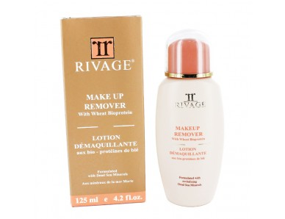
1. Cleaning of the skin
To clean the skin and prepare it for the treatment, we use three products of Rivage: Make-Up remover; Liquid Cleanser and Facial Wash Refresher Gel. These three products, when combined together, assure a good cleaning and prepare the skin canvas for an effective treatment.
If the treatment is done during the day, Facial Exfoliant cream may be added.

Slide 16
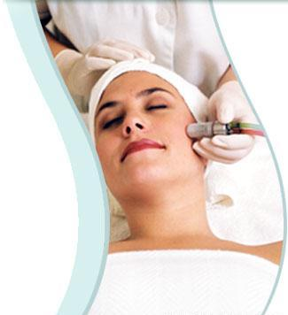
2. Microdermabrasion by Machine
The technique consists of moving the hand piece’s head gently on the face of the patient. The period of time you keep the head on a certain spot and the frequency of rotations on the face is determined by the skin necessities of the patient.

Slide 17

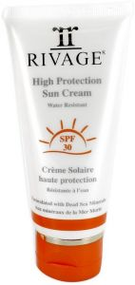
Replenishing and stabilizing the skin
To bring skin back to normal we also use a number of products which vary, depending on the time of the day the treatment was done at and on the type of skin of the patient. First product to use is Mineral Toner, which balances skin’s pH and helps close the micro ruptures in the skin. Followed by it is day or night cream, depending on the time of the day. The cream absolutely must be moisturizing, for the skin needs moisture after such a treatment in order to heal and replenish properly.
Finally, unless it is dark at night, we use sun protection, which we put at the very end of the treatment. This is essential for the treatment, because if the face enters in contact with UV rays after the treatment, it may create pigmentation spots, which are highly undesirable and may be dangerous.

Slide 18
Description
Crystals that are used are made of Aluminium Oxide; which is completely natural mineral without any combination of a chemical product. Aluminium Oxide is considered a low health risk when inhaled.
They used different levels based on the skin type. The epidermal layers are removed gently and safely over a course of treatments. In every following treatment, the intensity can be increased in order to reach deeper down the layers of the epidermis. The skin may develop a bigger tolerance to the treatment , therefore you may increase the level the treatment that follows.
The clients all have different type of skin , so people with problematic skin may need more treatment than usual. The maximum of treatment the clients are allowed are approximately 15-20 treatments

Slide 19
What to expect:
Effects of projection
The skin is reoxygenated, the small scars are blurred, the tissues are energized.
The skin appears younger, more toned and embellished (flash effect).
Effects of aspiration
The skin is softer to the touch and the new skin effect is immediately visible. Wrinkles and imperfections are softened (lifting effect).

Slide 20
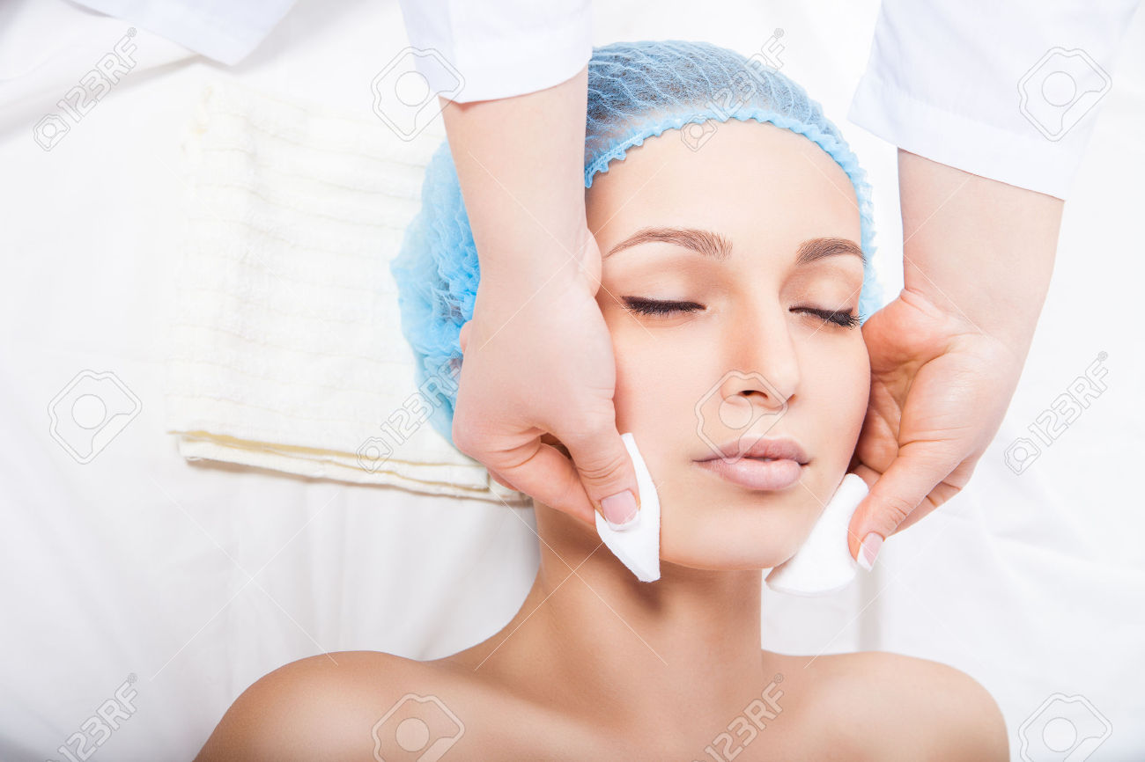
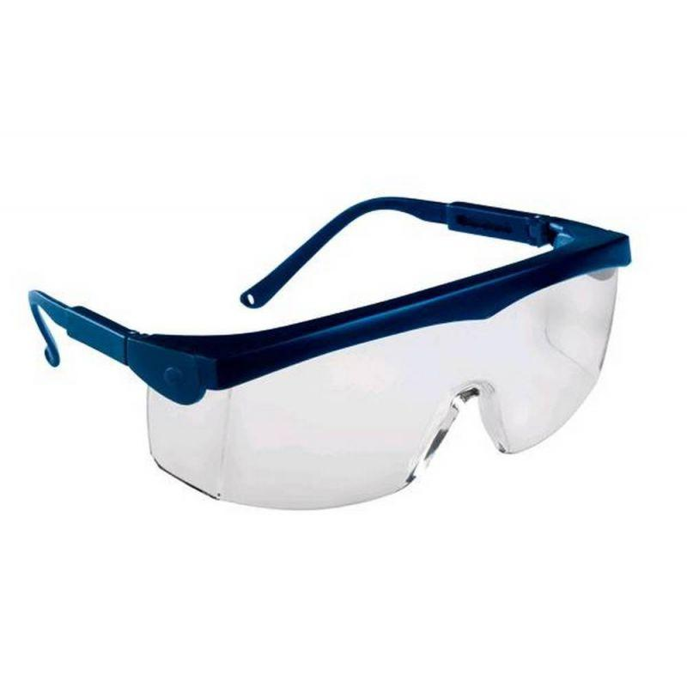
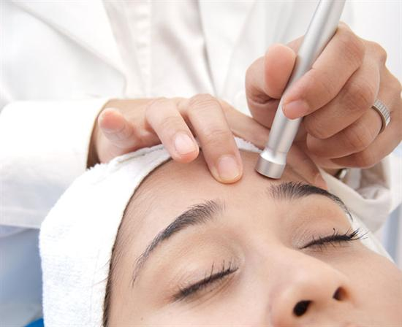
How to perform Microdermabrasion:
STEP1: Cleanse the skin using a calming gel or foam to remove impurities, dirt, oil and makeup; so the microdermabrasion treatment will penetrate deeper into the skin and provides a more even result
STEP2: Remove contact lenses and wear goggles to prevent crystals from flying into your eyes and causing damage during the procedure.
STEP3: Place the microdermabrasion wand against the skin. Wand is filled with aluminum oxide crystals, it will remove the top layers of skin. An included suction device will remove the crystals and exfoliate skin cells to create more clean workspace.

Slide 21

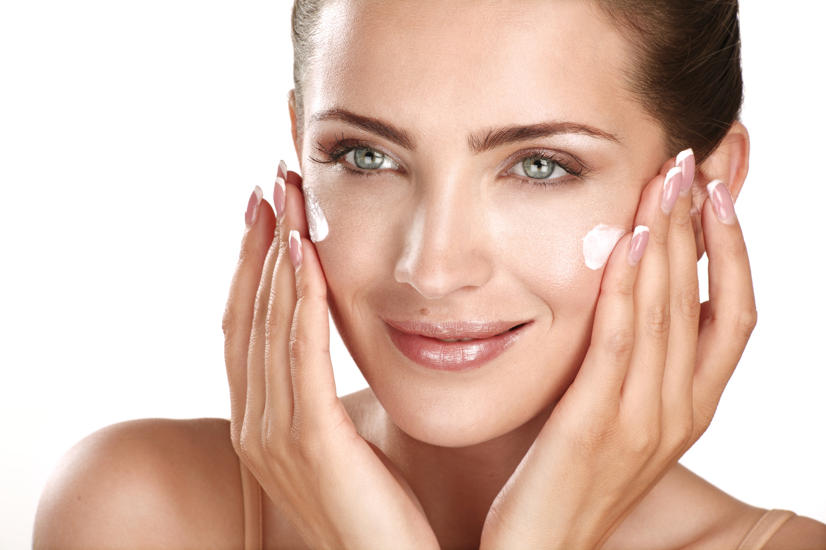
STEP4: Repeated treatments are required for optimum results. between treatment sessions clients should wait two to three weeks not to irritate the skin.
STEP5: The client should cleanse the skin with a mild cleanser and use oil-free lotion or moisturizer to keep the skin hydrated and to prevent unnecessary peeling. It is normal for the skin to look red or bit rough a few days following the treatment, though this should fade quickly.

